Slide 1
Antimicrobial Resistance
&
ASP
Sistanizad M.
Pharm. D., Critical Care Clinical Pharmacist
Antimicrobial Stewardship Committee
Emam Hossein Medical Center

Slide 2
Highlights
Why is AMR a Global Concern
How Germs Become Resistant and Spread
Cause of AMR and How to prevent AMR
AMR and Antimicrobial Consumption in Iran
Appropriate use of Abx
ASPs: antimicrobial stewardship programs

Slide 3
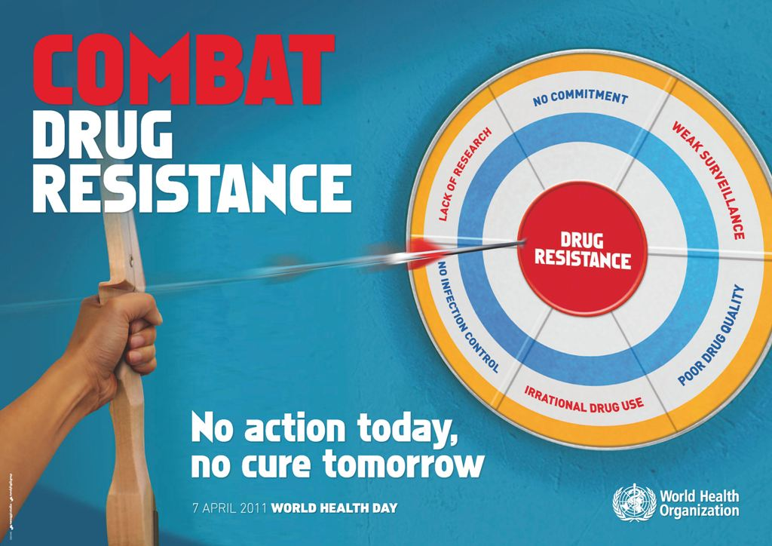
WHD 2011 slogan

Slide 4
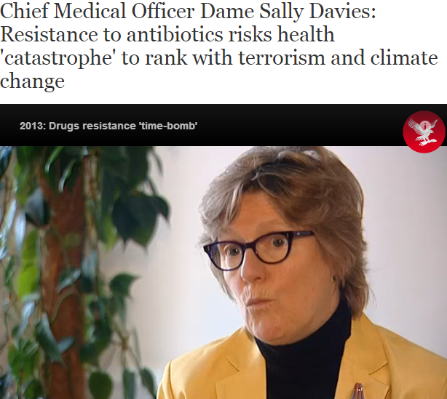
http://www.independent.co.uk/news, 2013

Slide 5
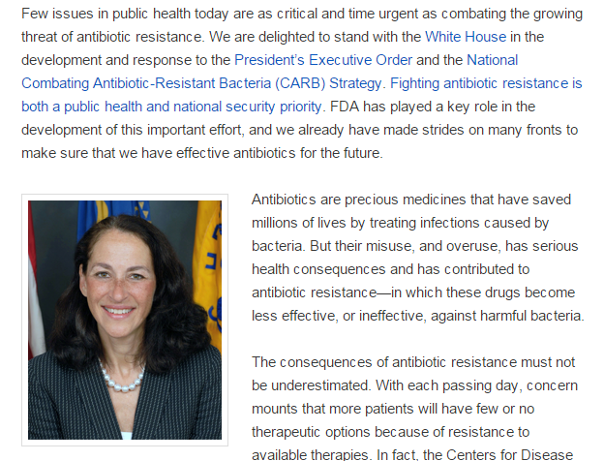

Slide 6
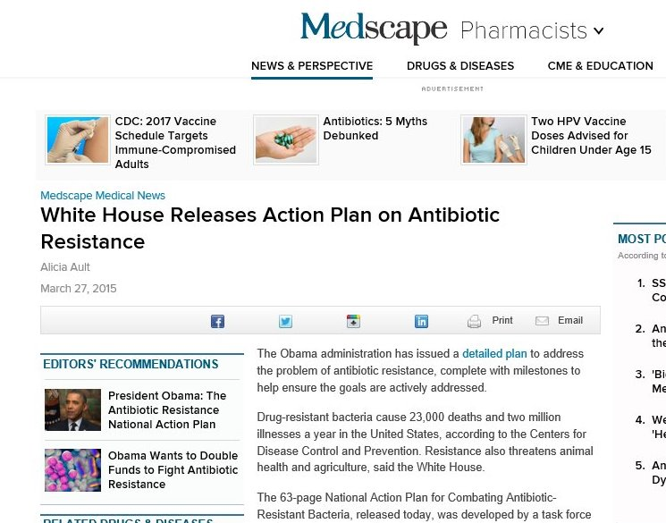

Slide 8
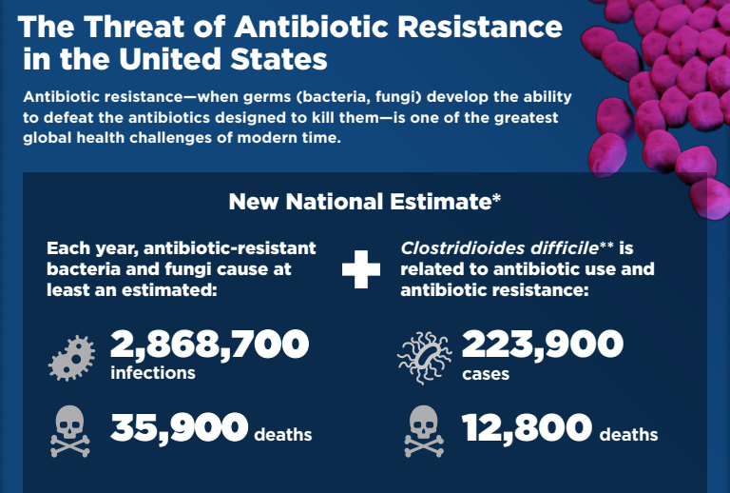

Slide 9
Why is AMR a global concern
Antibiotic resistance has the potential to affect people at any stage of life, making it one of the world’s most urgent public health problems.
Each year in the U.S.:
  at least 2.8 million infection
  more than 35,000 death (compared to 23,000 in 2016).
Many medical advances are dependent on the ability to fight infections using antibiotics, including joint replacements, organ transplants, cancer therapy, and treatment of chronic diseases like diabetes, asthma, and rheumatoid arthritis.
CDC, 2020

Slide 10
Why is AMR a global concern
Each year, more than 700,000 individuals die due to antimicrobial resistance (AMR) infections.
CDC, 2016

Slide 11
Mortality
Drug-resistant bacteria cause 35,000 deaths and 2.8 million illnesses a year in the United States, according to the Centers for Disease Control and Prevention. Resistance also threatens animal health and agriculture, said the White House
kills more Americans every year than emphysema, HIV/AIDS, Parkinson's disease, and homicide combined
Number of deaths due to HIV/AIDS in 2010: 8,369

Slide 12
Cost
Estimates vary but have ranged as high as $20 billion in excess direct healthcare costs, with additional costs to society for lost productivity as high as $35 billion a year (2008 dollars)
CDC, 2013

Slide 13
Mechanism of Resistance and Spread

Slide 14
How Germs Become Resistant and Spread
Germs (bacteria and fungi) are everywhere. Some help us. Some make people sick. Some of those germs are resistant to antibiotics.
Antibiotics kill germs that cause infections. But antibiotic-resistant germs find ways to survive. Antibiotics also kill good bacteria that protect the body from infection.
Antibiotic-resistant germs can multiply.
Once antibiotic resistance emerges, it can spread into new settings and between countries.

Slide 15

Geographic Spread Of ESBLs
Area C3
> 100 miles
Rate - 5%
Area B2
10-20 miles
Rate- 23%
Area B1
0-10 miles
Rate- 37%
Area C2
80-100 miles
Rate - 3%
Area C1
20-80 miles
Rate-9%
Hospital A
Rate- 58%
Monnet, et al. Infect. Control Hosp Epidemiol. 1997;18:492-8.
Notes:
Monnet, et al demonstrated the remarkable ability of ceftazidime-resistant Klebsiella pneumoniae to spread geographically in New York from a hospital with an outbreak to other facilities in surrounding areas. In this paper, in hospital A, the primary outbreak hospital, ceftazidime-resistance in Klebsiella pneumoniae had reached 57.7% of isolates, apparently serving as the reservoir for spread to other facilities. In the other facilities, the percentage of resistant isolates was directly proportional to the distance from the primary hospital. This is a sober reminder of the ability of bacteria to spread from facility to facility usually carried by healthcare workers and/or patients.

Slide 16
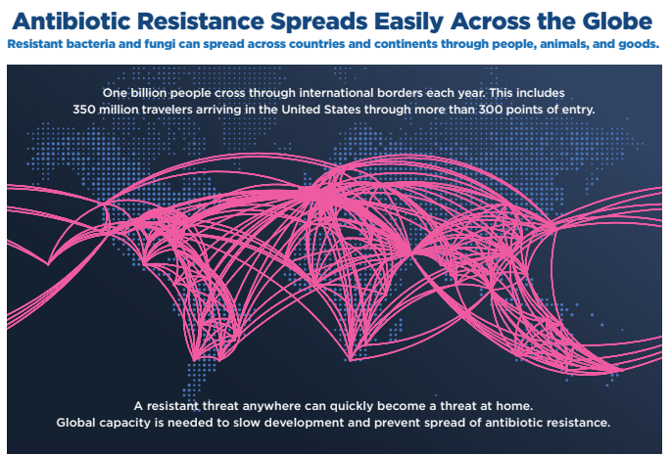

Slide 17
Cause of AMR and How to prevent AMR

Slide 18
Antimicrobial Resistance (AMR)
How much misuse?
The use and misuse of antimicrobial drugs is leading cause of AMR*
The use of antibiotics is the single most important factor leading to antibiotic resistance around the world$
*WHO factsheet, 2012
$CDC 2013

Slide 19
History
Fleming 1945: … microbes are educated to resist penicillin …

Slide 20
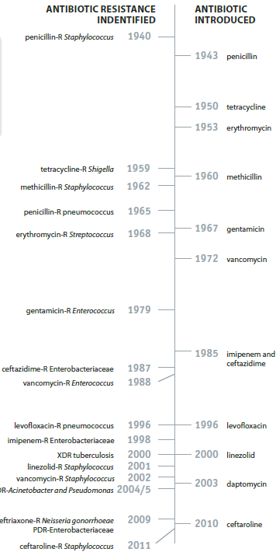

Slide 21
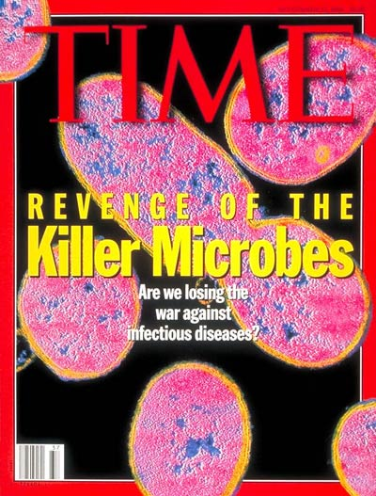

Slide 22
History of new Abx
Resistance to one antibiotic
Introduction of new antibiotic by pharmaceutical companies
?

Slide 23
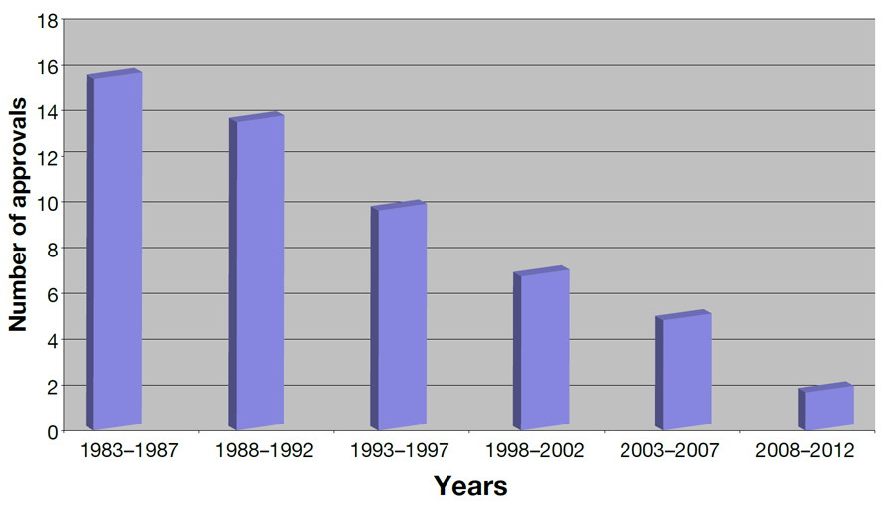
New Abx Approvals

Slide 24
How many Abx we need
IDSA has called for a worldwide commitment to develop at least 10 new systemic antibiotics by 2020
The IDSA says that pharmaceutical research and development needs to urgently focus on new agents to fight multiple drug resistant Gram-negative bacilli infections

Slide 25



Slide 26
راه حل
افزایش مقاومت میکروبی (مصرف نادرست)
کاهش سرعت کشف آنتی بیوتیکهای جدید
مصرف منطقی آنتی بیوتیکها

Slide 27
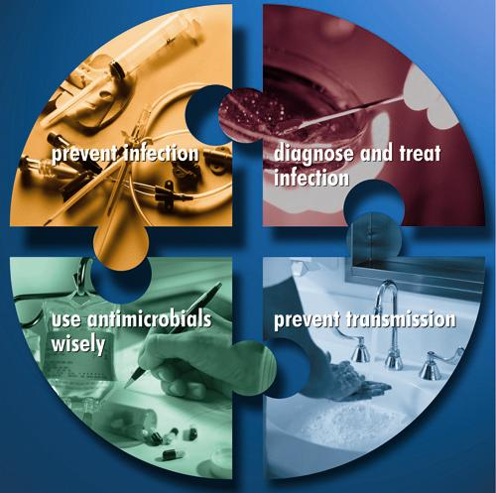
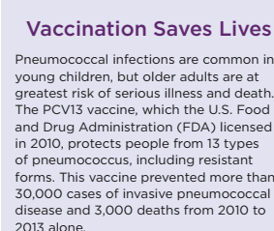
Key Prevention Strategies
Prevent infection
Diagnose and treat infection effectively
Use antimicrobials wisely
Prevent transmission
Notes:
These 4 strategies—preventing infection, diagnosing and treating infection effectively, using antimicrobials wisely, and preventing transmission—form the framework for the CDC’s Campaign to Prevent Antimicrobial Resistance
Clinicians and their patient care partners hold the solution to integrating these strategies into daily practice and optimizing the care and safety of all patients

Slide 28
AMR and Antimicrobial Consumption in Iran

Slide 29
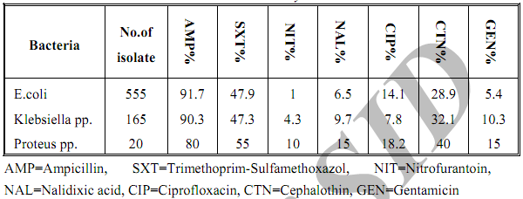
UTI- Kashan
Antimicrobial Resistance in Gram-negative…, Arch. Razi Ins, 2003.
Notes:
Coagulase negetive staph

Slide 30


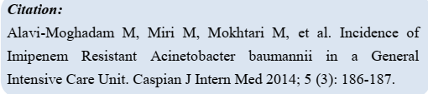

Slide 31
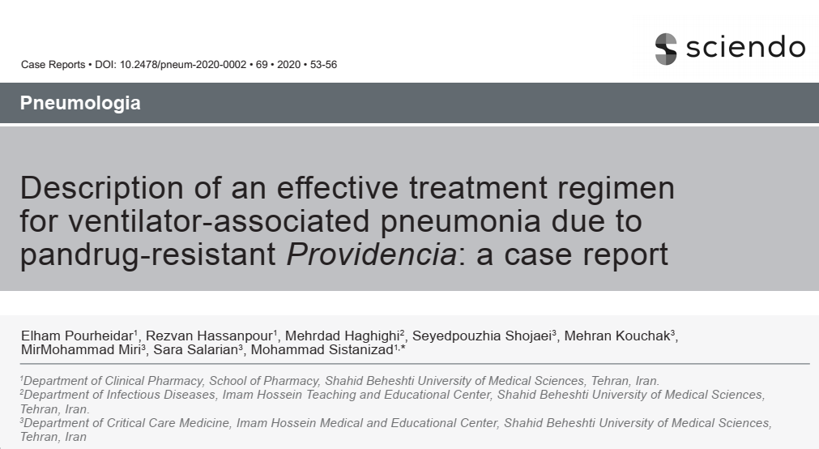

Slide 32
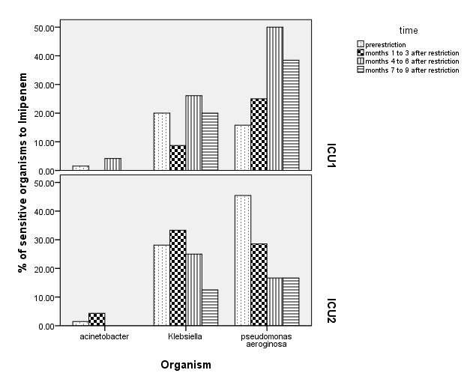

Slide 33
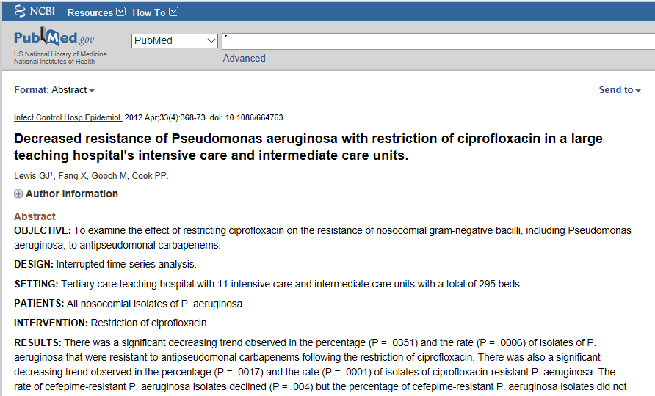

Slide 34
مصرف آنتی بیوتیک در ایران

Slide 35
Antimicrobial Consumption in Iran

Slide 36
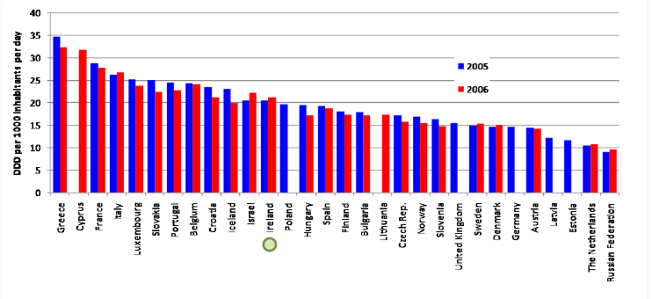
Antimicrobial Consumption in European Countries
Total outpatient antibiotic use in Europe 2005 and 2006 expressed in DDD per 1000 inhabitants per day. Data from the European Surveillance of Antimicrobial Consumption (ESAC) project’s 2006 year book

Slide 37
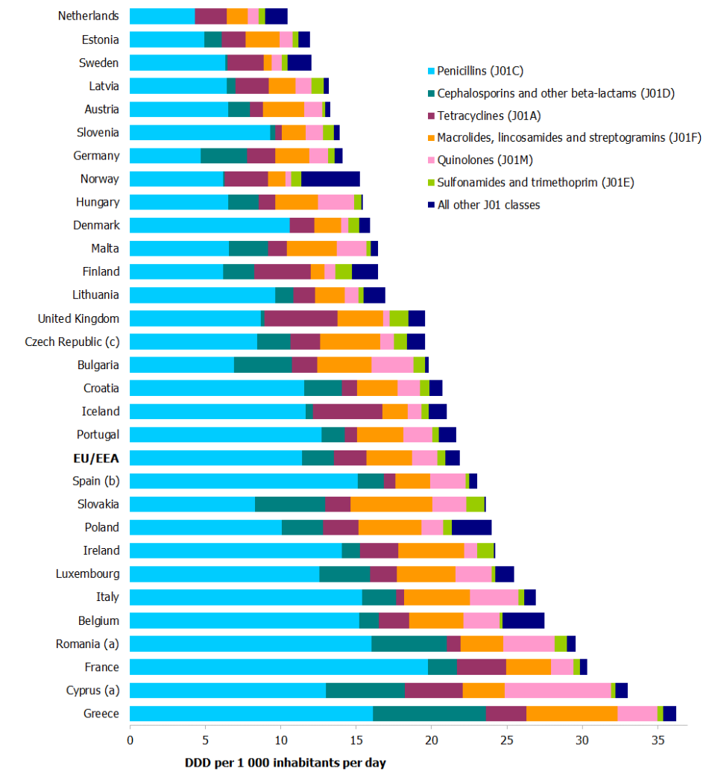

Slide 38
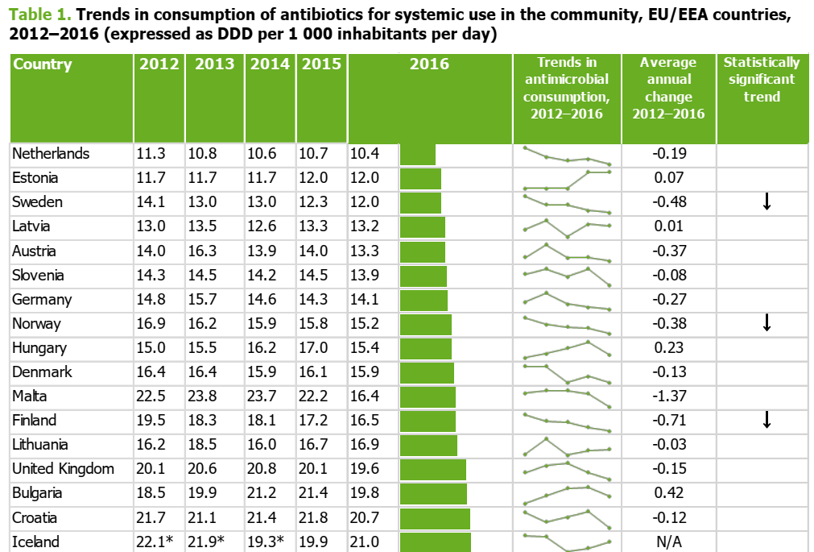

Slide 39
Main Points
DDD/1000 در ایران تقریبا 5 برابر متوسط کشورهای اروپایی است
متوسط مصرف آنتی بیوتیک غیر تزریقی در یک روز در سال 1388 معادل 940 میلیون تومان بوده است
اگر مصرف آنتی بیوتیک در کشور به استانداردهای کشورهای اروپایی نزدیک شود روزانه 752 میلیون تومان فقط در هزینه مصرف دارو در کشور صرفه جویی خواهد شد یعنی 268 میلیارد تومان در یک سال

Slide 40
Main Points
متوسط هزینه ساخت یک بیمارستان 100 تختخوابی 10 میلیارد تومان است. یعنی هر سال 26 بیمارستان 100 تختخوابی
بیشترین آنتی بیوتیک در بیماران سرپایی برای عفونتهای تنفسی تجویز می گردد این در حالی است که بیشتر این عفونتها خودبخود محدود شونده هستند
Wise R, Hart T, Cars O, et al. Antimicrobial Resistance is a major threat to public health.
BMJ 1998;317:609-10.

Slide 41

The only thing we can do immediately to monitor resistance is to make better use of available antibiotics

Slide 42

Thanks for your attention

